Slide 1
Design and Implementation of Segmentation Adder
Brijin G URK22EC1021
Gladwin Jebas J URK22EC1031
Aldrin Infant Raj F URK22EC1069

Slide 2
Outline
Abstract
Introduction
Design Methodology
Conclusion
References

Slide 3
Abstract
Abstract is to design and simulate the Segmentation Adder in Skywater 130 PDK.
The design is described in Verilog and synthesized using the OpenLane flow.
Key physical design steps
1) Floorplanning
2) Placement
3) Routing

Slide 4
Introduction
Segmentation Adder
A Segmentation Adder is an optimized adder architecture that improves speed and reduces delay by dividing the operands into smaller segments and performing partial additions in parallel.
Tools Used
Software Used
1) Vivado 2024.2
2) Skywater 130 PDK
i) GTK wave
ii) Yosys
iii) OpenLane
Hardware Used
1) Basys 3 FPGA board

Slide 5
Methodology
Implemetation of Segmentation Adder in FPGA board
i) The first step is to implement the segmentation adder Vivado code in the Basys 3 FPGA board and see the results.
ii) An error is identified that the Junction Temperature exceeded, To avoid this Heating issue we implemented a 4 bit segmentation adder with overflow bit.
iii) The next step is to implement the power analysed segmentation adder Vivado code in the Basys 3 FPGA board and compare the results.

Slide 6
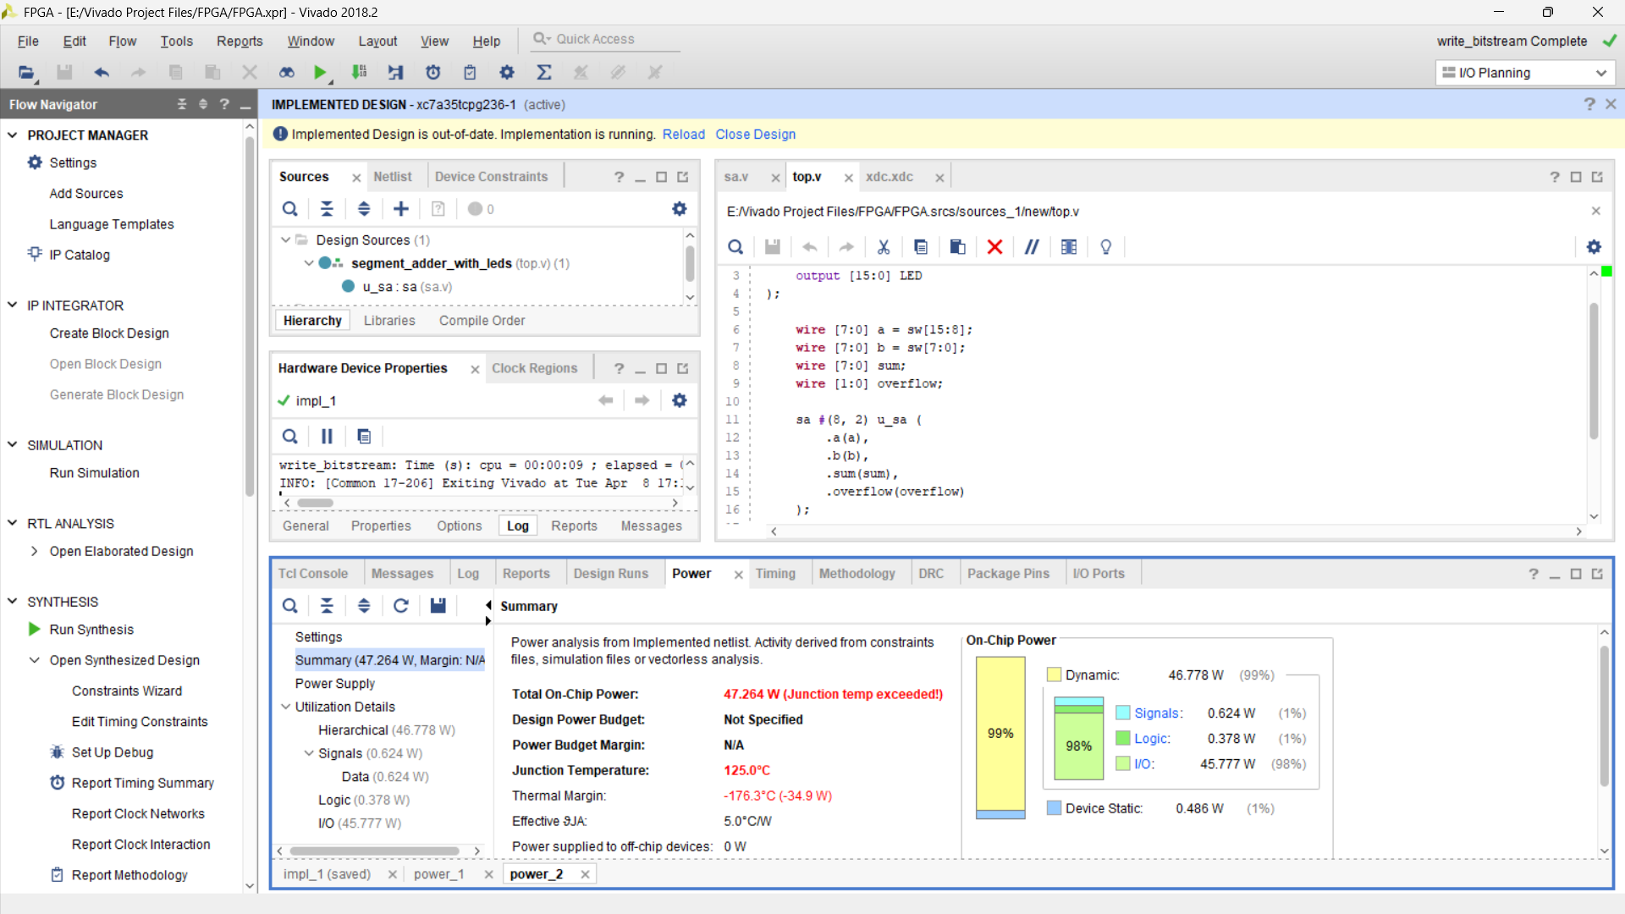
Methodology

Slide 7
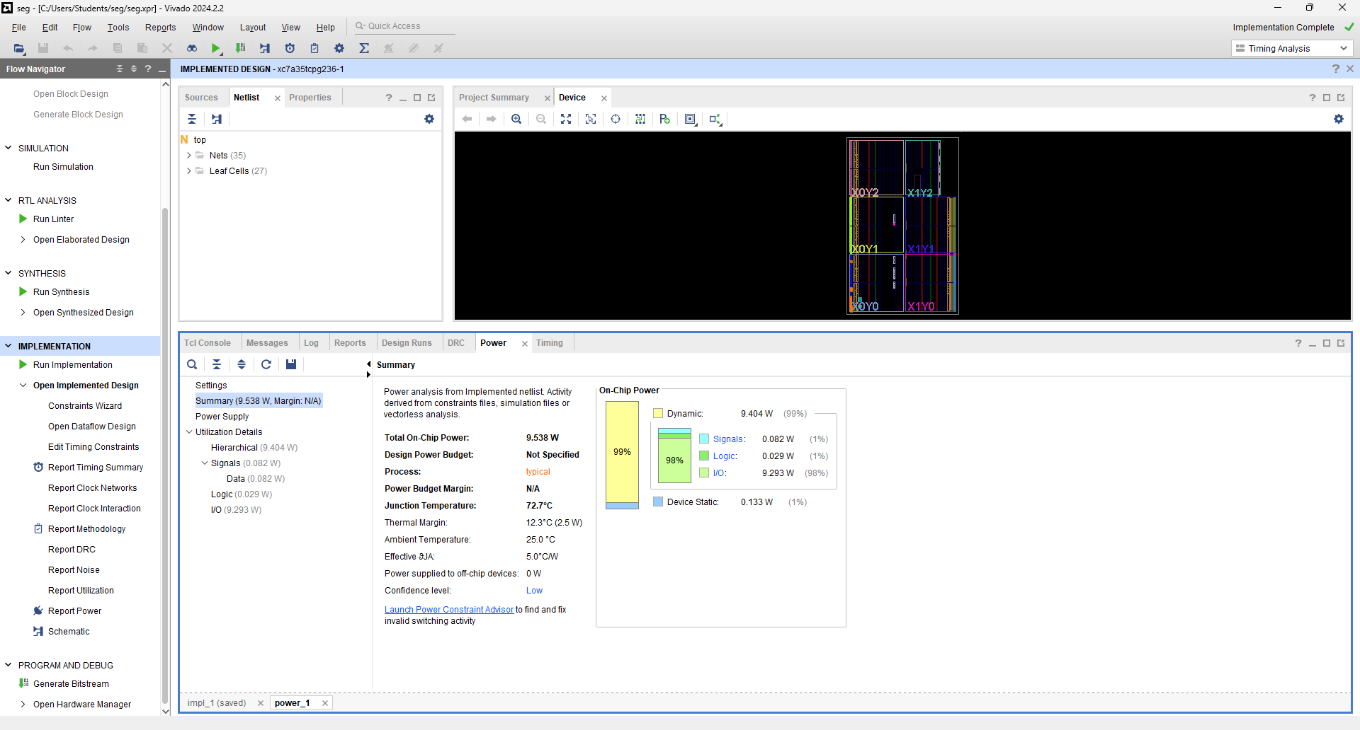
Methodology

Slide 8
Methodology
Implemetation of Segmentation Adder in FPGA board
i) The first step is to implement the segmentation adder Vivado code in the Basys 3 FPGA board and see the results.
ii) An error is identified that the Junction Temperature exceeded, To avoid this Heating issue we implemented a 4 bit segmentation adder with overflow bit.
iii) The next step is to implement the power analysed segmentation adder Vivado code in the Basys 3 FPGA board and compare the results.
Skywater Implementation
i) GTKwave
Generate a .vcd file to get the Input and Output waveforms.
Vcd file stores all signal changes over time, so tools like GTKWave can visualize them as waveforms.

Slide 9
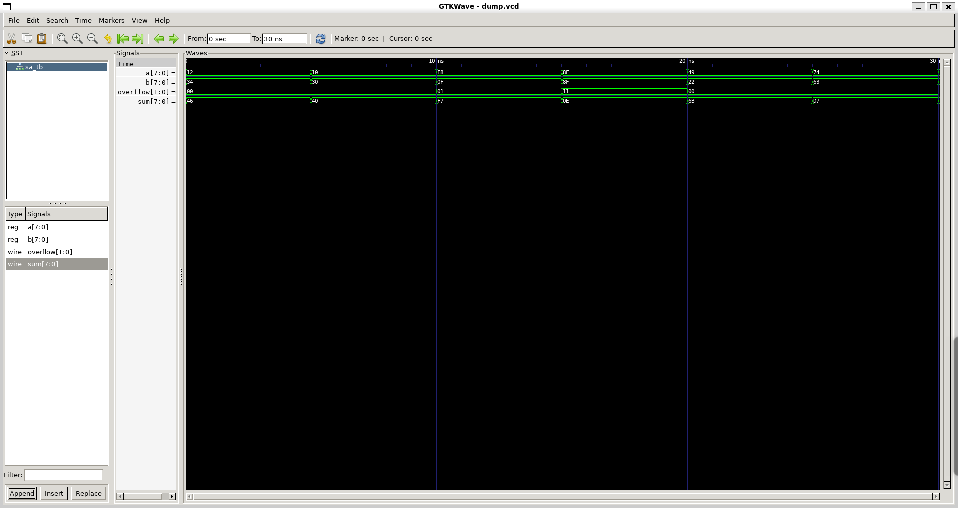
Methodology
GTK wave

Slide 10
Methodology
Yosys
Yosys is an open-source digital synthesis tool.
It takes your RTL (.v file) and turns it into a gate-level netlist.
A gate-level netlist is a structural Verilog file that describes your digital logic entirely using standard cells like AND, OR, NAND, flip-flops, etc.

Slide 11
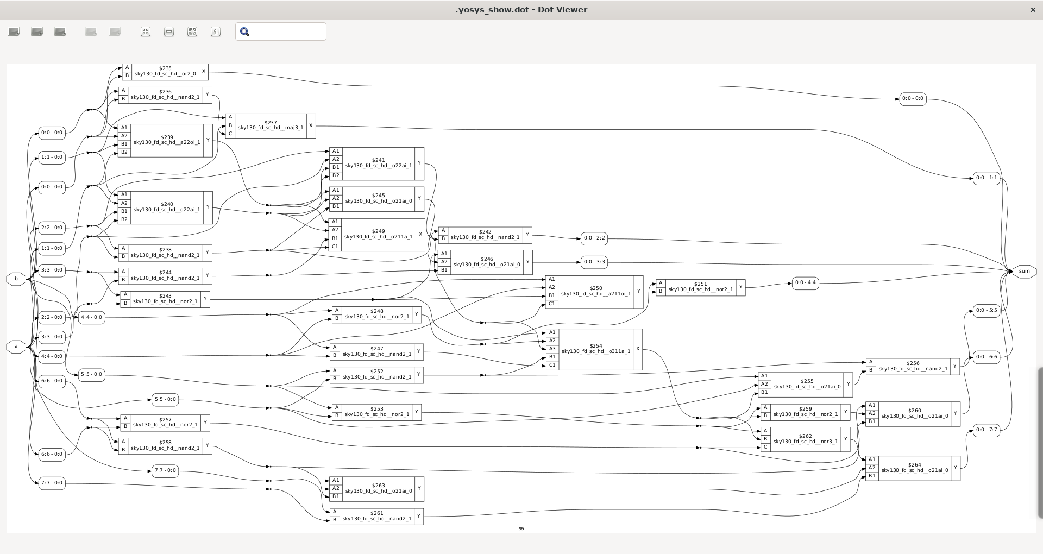
Methodology
Yosys

Slide 12
Methodology
OpenLane
OpenLane is an automated digital ASIC design flow that wraps tools like:
Yosys (synthesis).
ASIC design flow
1) Floorplanning
2) Placement
3) Routing

Slide 13
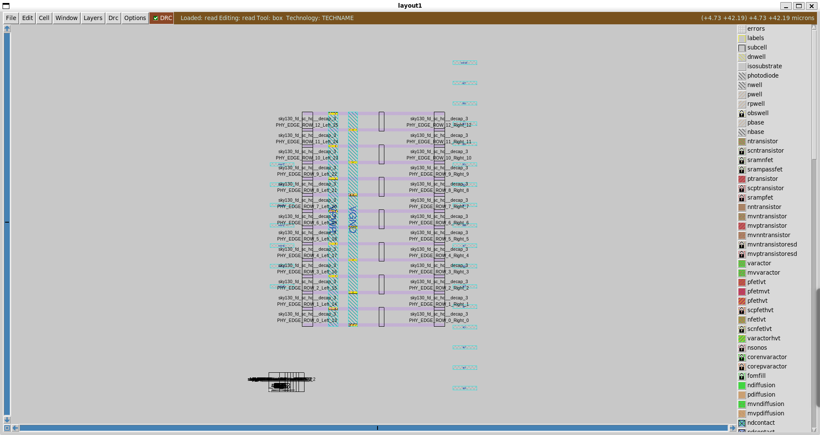
Methodology
Floorplanning
Floorplanning is the first physical design step where you take your synthesized logic design (netlist) and decide how it will be laid out on silicon, like sketching the blueprint of a building before construction.

Slide 14
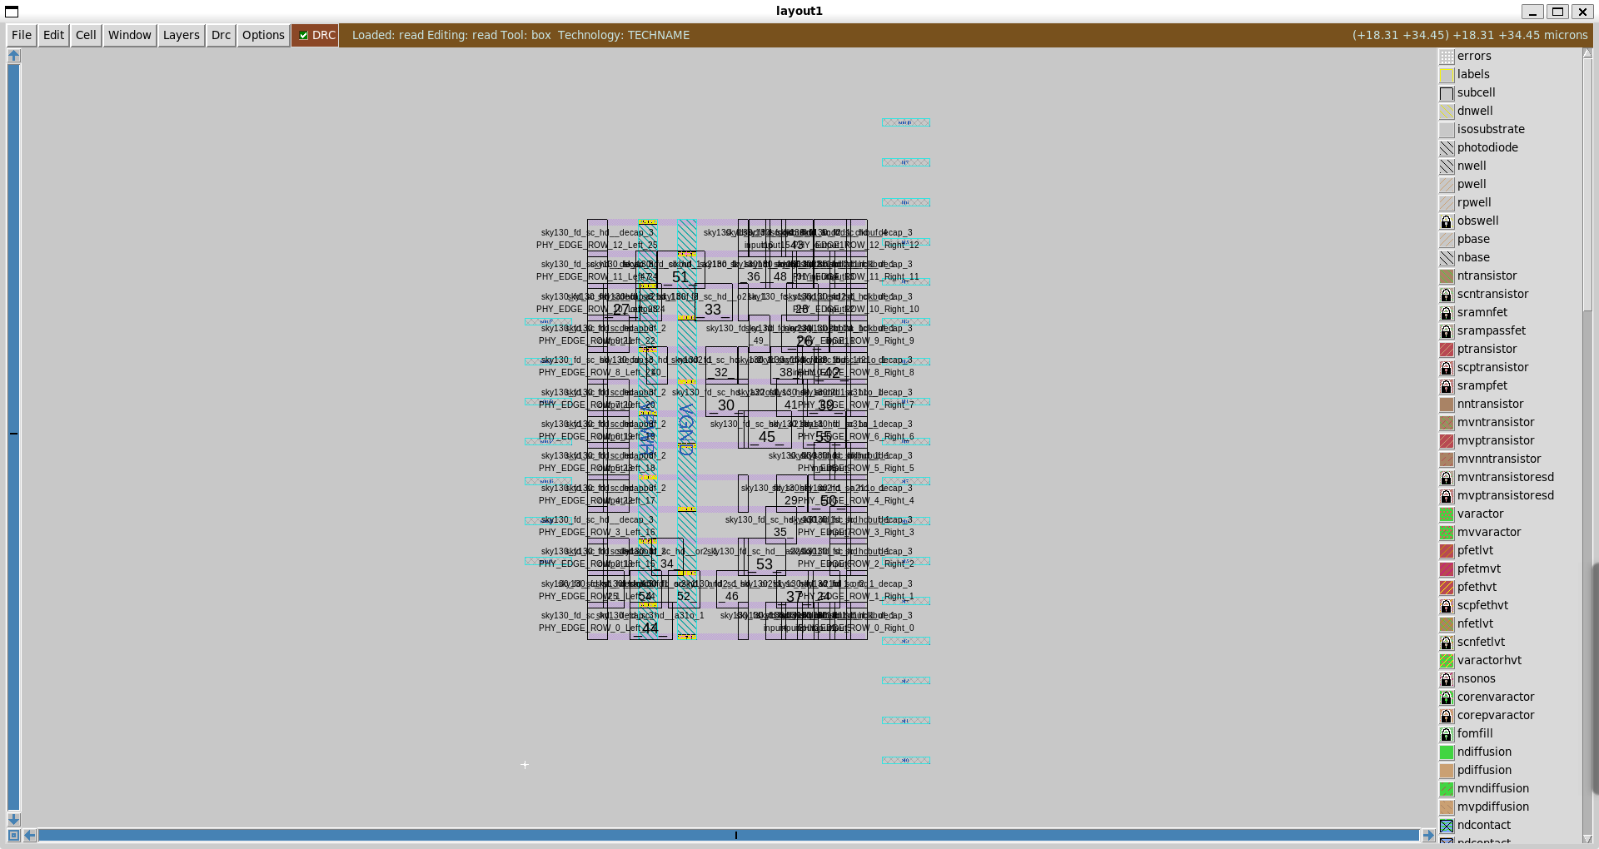
Methodology
2) Placement
Once the floorplan is ready, the next crucial step in the physical design flow is Placement. This process involves placing all your standard cells and macros (pre-designed IP blocks) within the core area of the chip.

Slide 15
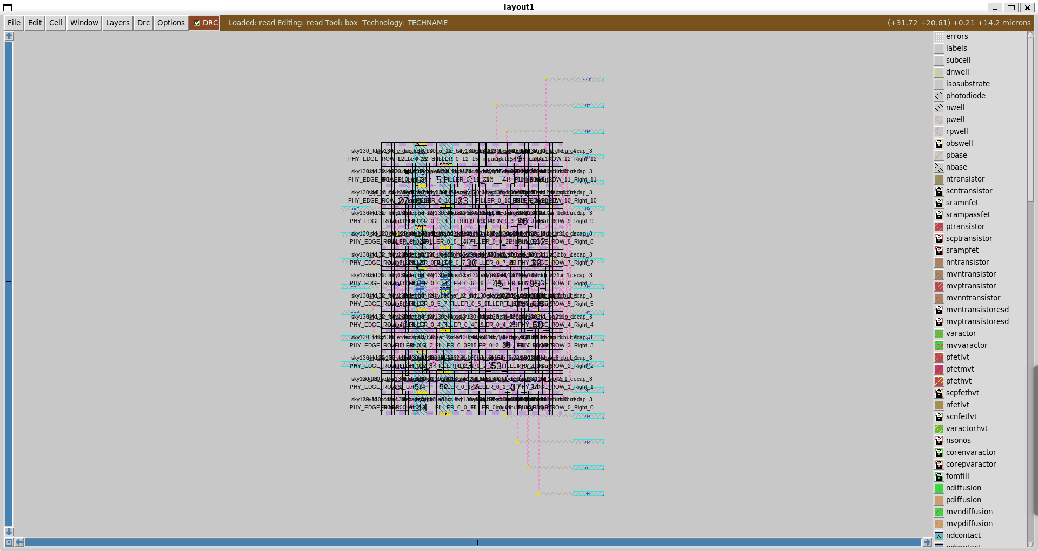
Methodology
3) Routing
Once all standard cells and macros are placed on the silicon die (in rows or fixed locations), Routing is the process of physically connecting them with metal wires based on their logical connections from the netlist.

Slide 16
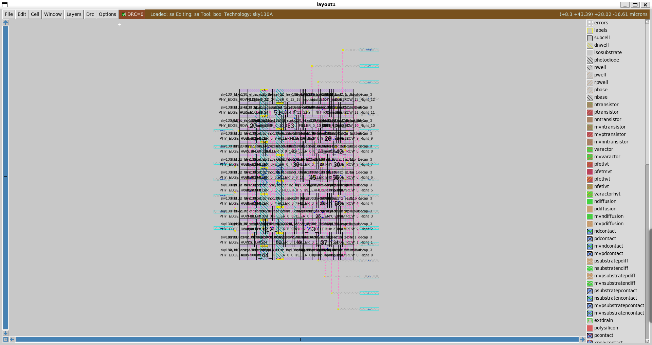
Methodology
Final output

Slide 17
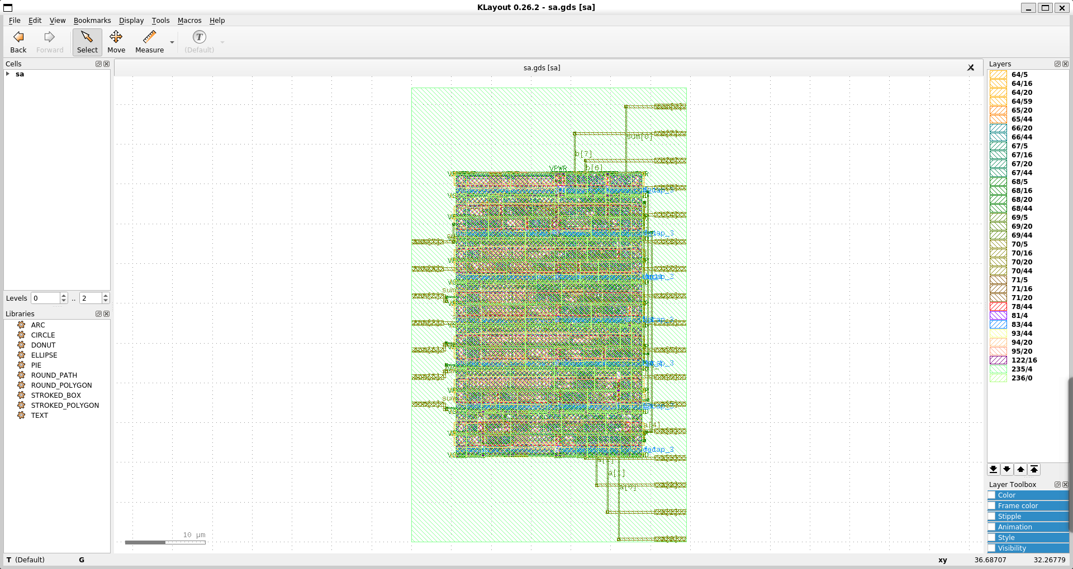
Methodology
GDS II

Slide 18
Conclusions
The physical design flow using OpenLane and the Sky130 PDK involves three critical stages:
Floorplanning, where the chip's physical layout and power structure are defined.
Placement, where logic cells are arranged efficiently to meet timing and area goals.
Routing, where all components are physically connected with metal layers, finalizing the design for fabrication.
Together, these steps transform a synthesized digital design into a manufacturable silicon layout.

Slide 19
Comparison Table
Feature | 8-Bit Segmented Adder | 4-Bit Segmented Adder | Change/Trend
Adder Bit-Width | 8 bits | 4 bits | Decrease
Input Switches | 16 | 8 | Decrease
Sum Output LEDs | 8 | 4 | Decrease
Overflow LED | 1 | 1 | No Change
Slice LUTs | 9 | 9 | No Significant Change
Bonded IOBs | 18 | Likely around 12-17 | Decrease
Dynamic Power | Higher (0.624 W) | Lower (0.014 W) | Significant Decrease
Static Power | Higher (46.660 W) | Lower (0.033 W) | Significant Decrease
Total On-Chip Power | Higher (47.284 W) | Lower (0.047 W) | Significant Decrease
Junction Temperature | Exceeding Limit | Within Limit (72.7 °C) | Significant Improvement
Timing Slack (WNS) | Positive (2.001 ns) | Likely Higher | Increase Expected

Slide 20
References
SkyWater Technology Foundry. Sky130 PDK Documentation.
https://github.com/google/skywater-pdk (Official open-source 130nm Process Design Kit used in RTL-to-GDS flow)
OpenLane Project – Efabless Corporation. OpenLane:
Open-source ASIC implementation flow. https://github.com/TheOpenROAD-Project/OpenLane (Tool used for floorplanning, placement, and routing)
Yosys Open SYnthesis Suite
https://yosyshq.net/yosys/ (Tool used for RTL synthesis of Verilog designs)
GTKWave
http://gtkwave.sourceforge.net/ (Tool used for waveform visualization from VCD files)
KLayout - Layout Viewer for IC Design
https://www.klayout.de/ (Used to view and verify GDSII layouts)

